Slide 1

Eternal International Business OPP
WELCOME
ETERNAL INTERNATIONAL KENYA

Slide 2
COMPANY PROFILE
Founded in China, Guangzhou early 2000
Went to other countries such as Kenya and many other within the continent.
In Kenya it came in 2025 March

Slide 3
COMPANY PROFILE
Has been operating in Kenya since early March 2025
We have various offices in Nairobi.
Other offices are at Jeevan Bharati building (Nairobi town center) ,TSS towers 10th floor in Mombasa city and all other major towns in kenya.
Registered by Ministry of Health, Pharmacy and Poisons Board and Kenya Bureau of Standard(KEBS)

Slide 4
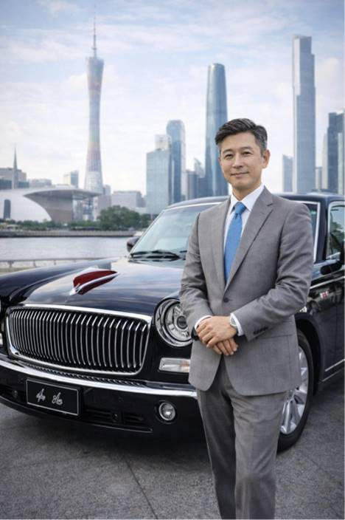
CEO Prof. Lee Zhang

Slide 5
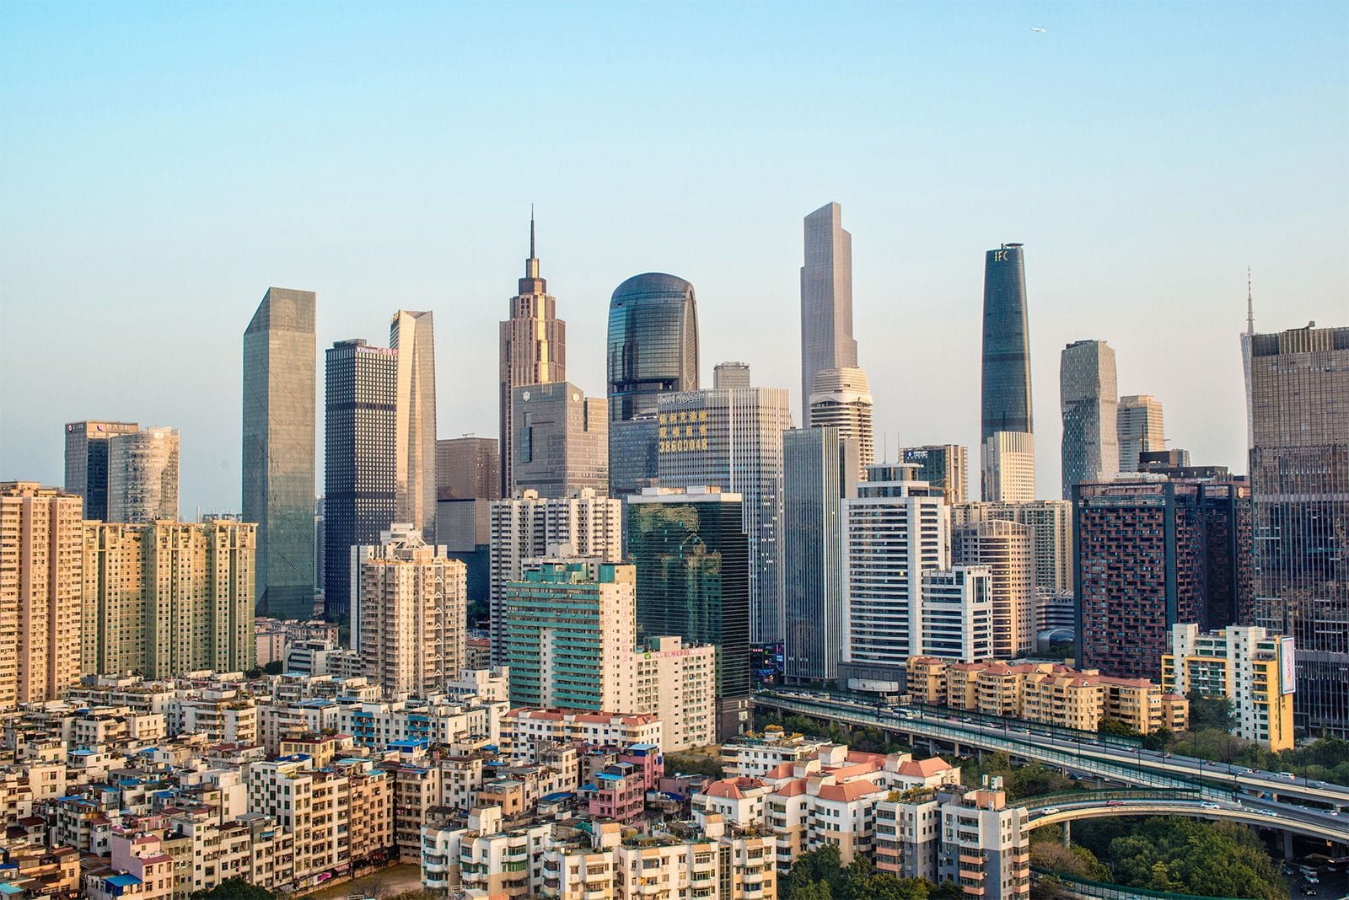
Mission
Eternal International Health and Products Mission is to improve lives by providing quality health and wellness products, empowering individuals through business opportunities, and building a stronger, healthier, and more successful community.
Slogan
Eternal International health and products focuses on providing good health and financial growth as they go.

Slide 6
MAIN COMPANY FOCUS
Health solutions promoting better well-being through our products and services.
Wealth creation
Giving people an opportunity to grow financially through the business.
Personal development
Building confidence, leadership, and success in individuals.
Community impact Creating a strong network of people helping each other grow.

Slide 7
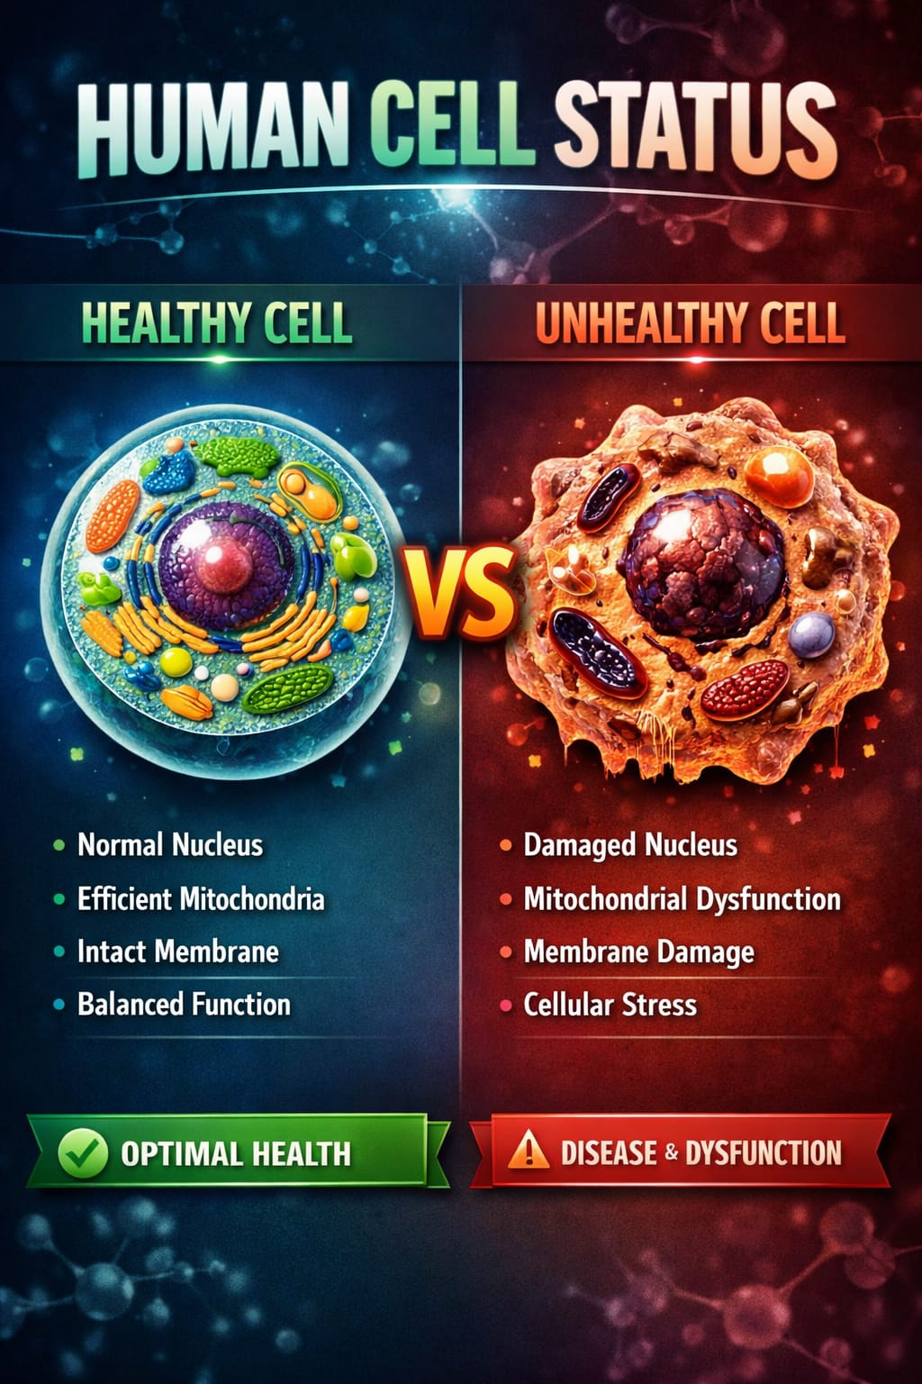

Slide 8


Slide 9


Slide 10

PREVENTION

Slide 11


Slide 12


Slide 13


Slide 14


Slide 15


Slide 16


Slide 17

BUSINESS OPPORTUNITY

Slide 18
ETERNAL OPERATING SYSTEM
ETERNAL 1%=99%=100%
OTHER SYSTEMS
100%=100%=100%

Slide 19

HOW TO PARTNER.

Slide 20
PAYMENT SYSTEM
DAILY BONUSES
A. SPONSORING KSH 3,900/=,
BONUS KSH 1,300=
B. FULL BODY SCANNING AT KSH 1,500,
BONUS KSH 800/=
C. 20% RETAIL PROFIT ON ALL OUR PRODUCTS

Slide 21
SPONSORING BONUS
1%
YOU
KSH 3900(30Usd)
1300 (10 Usd)
1300(10Usd)
1300(10 usd)
1300(10 usd)
1300(10 usd)
1300 (10usd)
99%
ANNA
PENDO
FATMA
JOHN
ROSE
NEEMA
KSH
3900(30 Usd)
KSH
3900(30 Usd)
KSH 3900(30 Usd)
KSH 3900(30 Usd)
KSH 3900(30 Usd)
KSH 3900(30Usd)

Slide 22
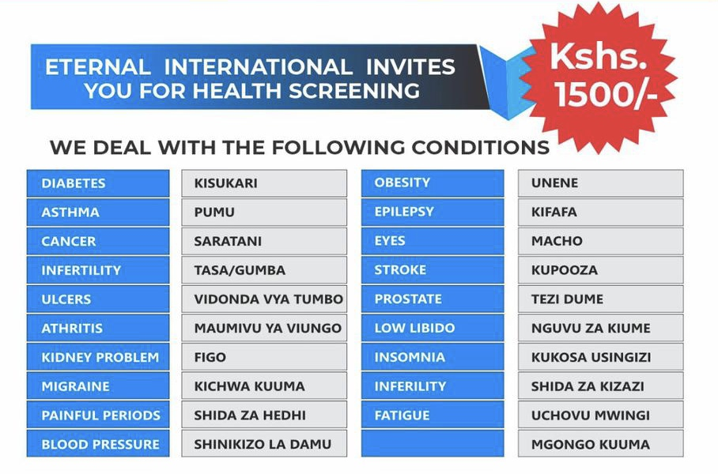
FULL BODY SCANNING BONUS

Slide 23
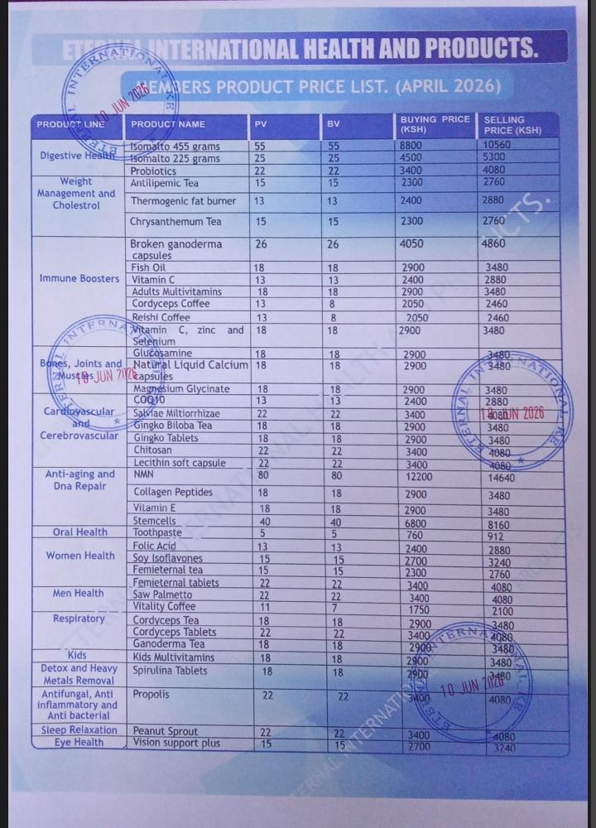
RETAIL BONUS

Slide 24
2.MONTHLY PAYMENTS
A. SALES BONUS
B. TEAM DEVELOPMENT BONUS
C. CASH AWARDS AMONG OTHER BONUSES

Slide 25
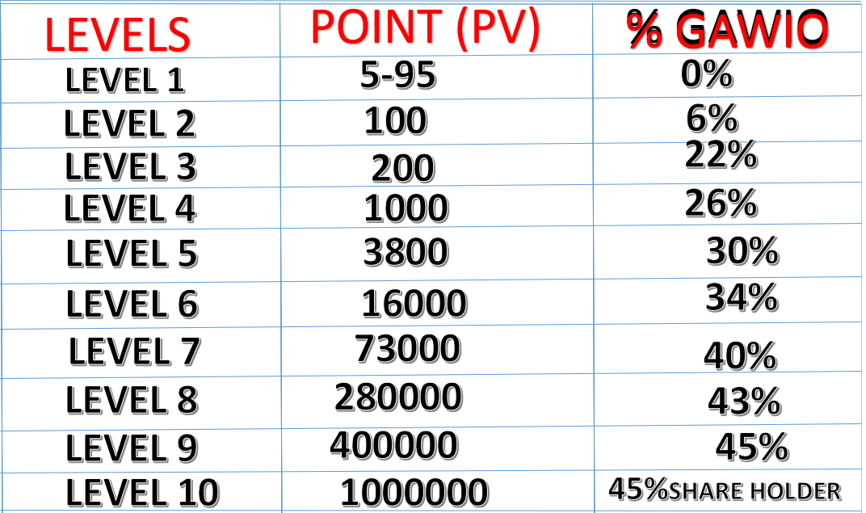
SALES BONUS
Sales bonus is the amount of points done, multiplied by the percentage of your sales
Bonus Level then multiplied by ksh. 130
EXAMPLE
(1000PV x 26% x 130) = Ksh 33,800
(260 USD)
KANUNI YA MALIPO
PV X % X 2200(1USD)
Mf. 1500 x 26% x 2200 = 858,000

Slide 26
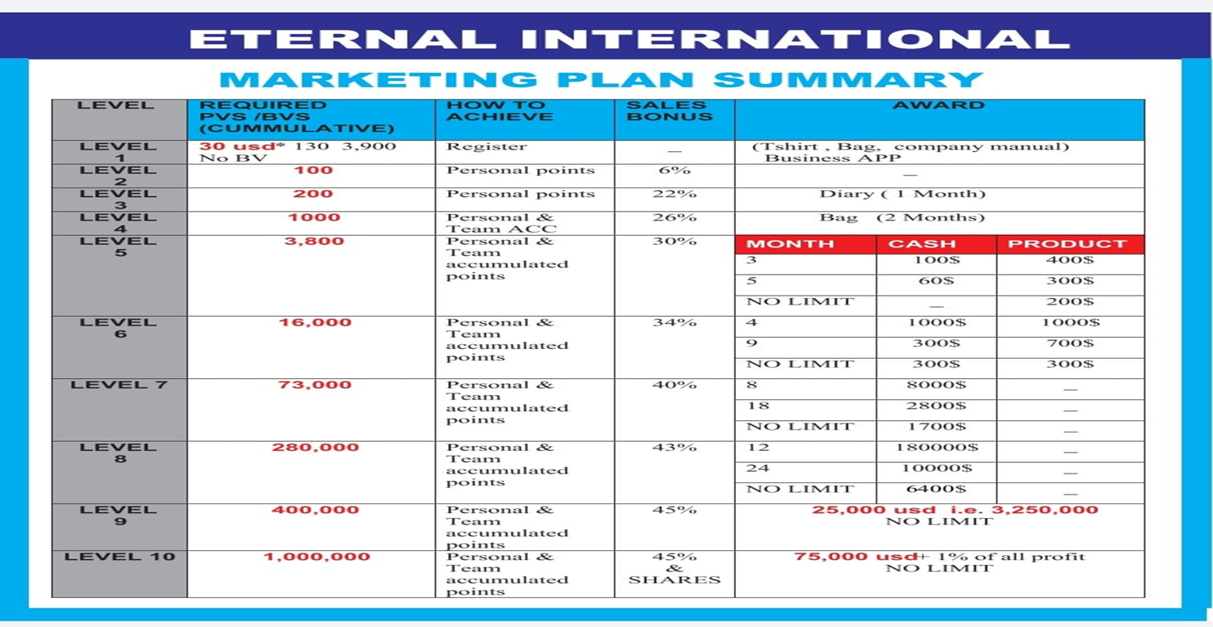

Slide 27
DEVELOPMENT BONUS
(1%)YOU
YOU
1500pv
30%
130
=58,500
(450 Usd)
JUMLA YA MAUZO BINAFSI NA TEAM
X
X
1,500PV
MALIPO YA TEAM
30%-26%=4%
6000 X 4% X 2200=528,000/
+
= 7500PV
4%
(99%)TEAM
6000PV
1500PV
JUMLA YA MALIPO BINAFSA NA TEAM
990,000+528,000= 1,518,000
X
X
130
=31,200
6000pv
4%
DARAJA LA 5 (30%)
BINAFSI
1500 X 30% X 2200=990,000
= 89,700
(690 Usd)
+
(100%)JUMLA:
58,500
(450Usd)
31,200
(240)
ANNA
PENDO
FATMA
JOHN
ROSE
NEEMA
1,000 PV
1,000 PV
1,000PV
1,000 PV
1,000 PV
1,000 PV
4 / 26%
4 / 26%
4 / 26%
4 / 26%
4 / 26%
4 / 26%
KSH 33,800
(260Usd)
KSH 33,800
(260 Usd)
KSH 33,800
(260 Usd)
KSH 33,800
(260 Usd)
KSH 33,800
(260Usd)
KSH33,800
(260Usd)

Slide 28

TRAVEL INCENTIVES

Slide 29


Slide 30
SUCCESS STORIES FROM KENYA

Slide 31
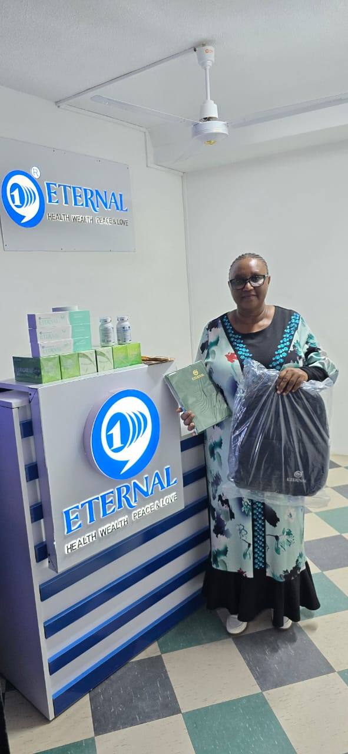


LEADER ROTICH 2,000USD AWARD FOR LEVEL 6,5,4,3

Slide 32
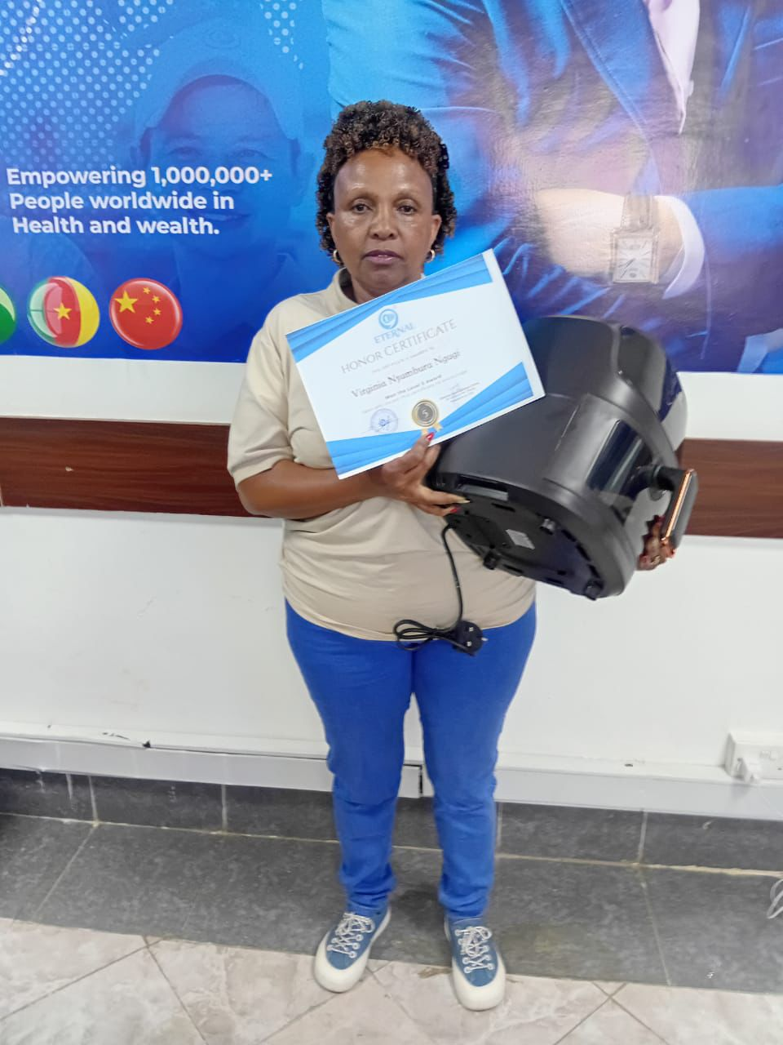


NGUGI; REWARD OF LEVEL 4,5 AND 6 LEADER

Slide 33
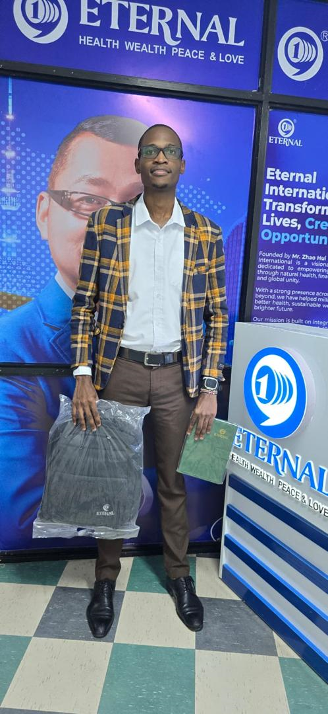

LEADER WILLIAM 2,000USD AWARD FOR LEVEL 6

Slide 34


DIRECTOR CECILIA N .MBURU AWARD FOR LEVEL 6 ONE MONTH AND 7 FOR 5 MONTH

Slide 35
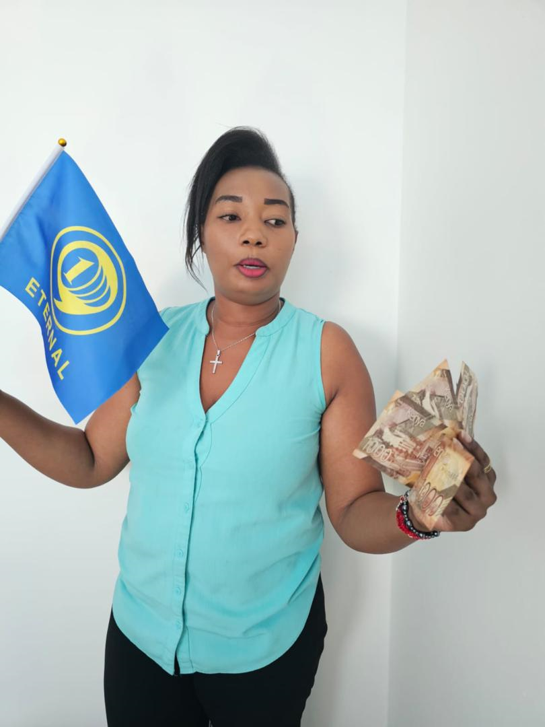
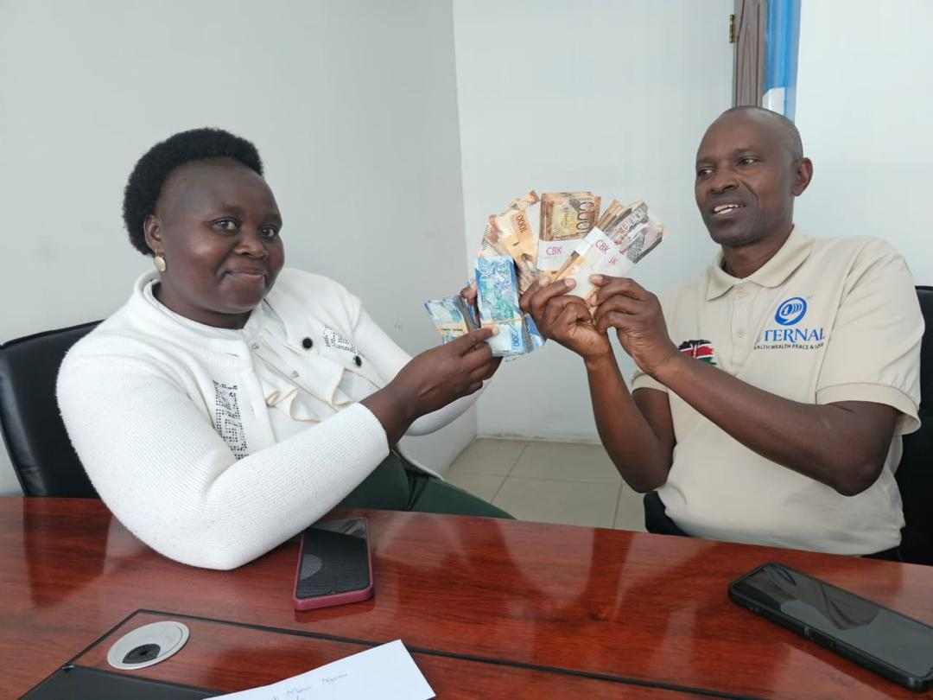
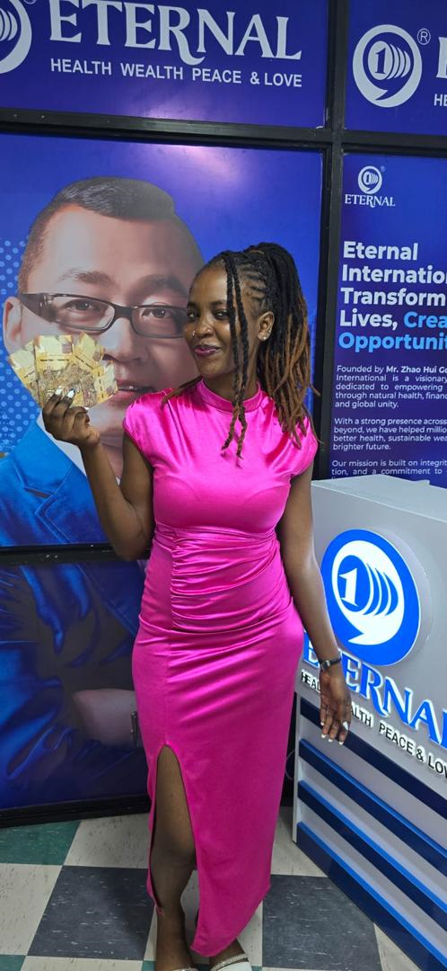
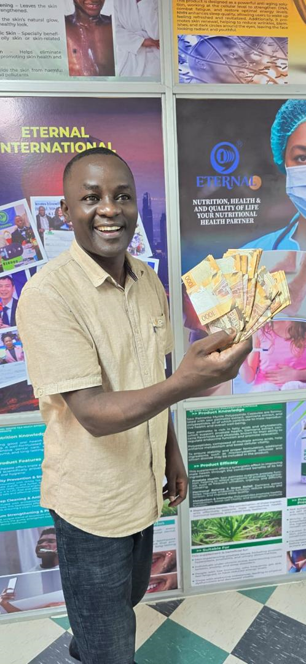
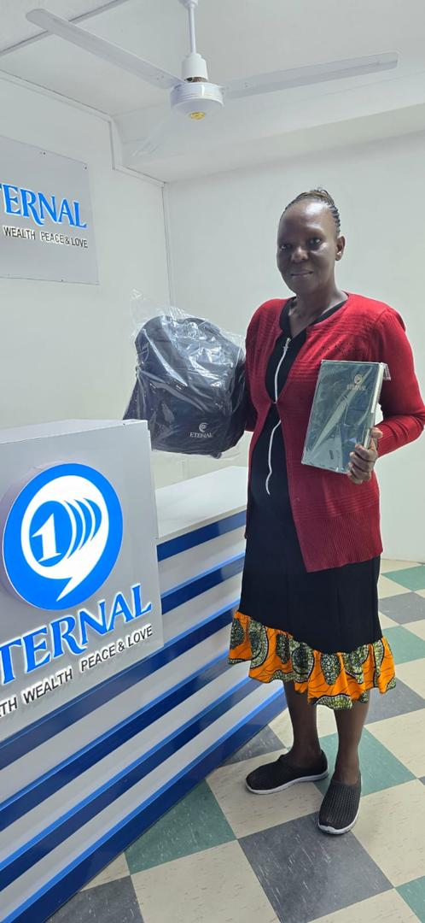
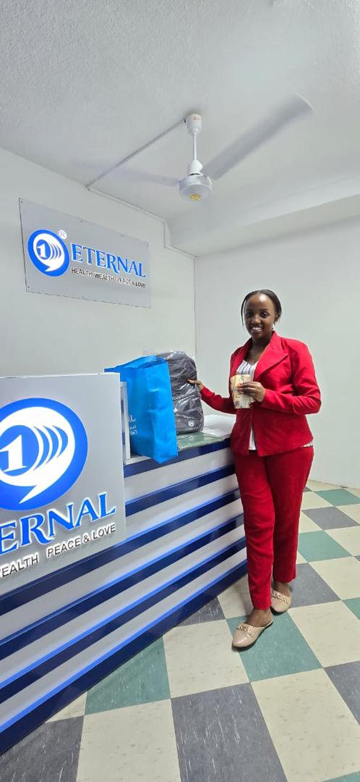
LEADERS: AWARDS FOR LEVEL 3,4 AND 5

Slide 36


Slide 37


Slide 38
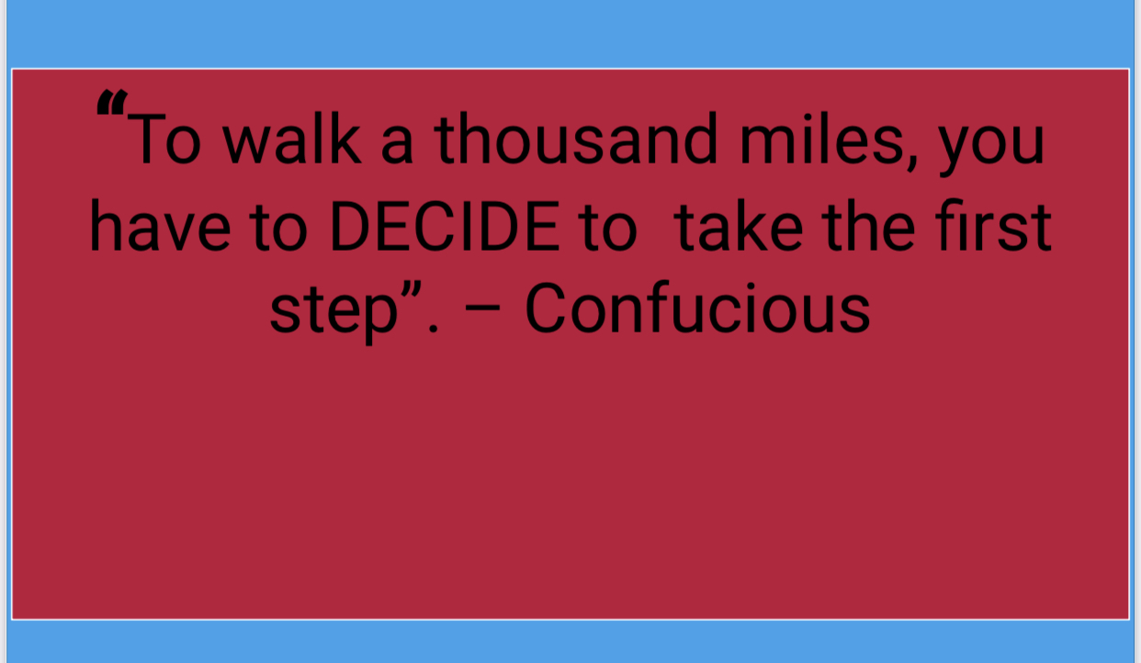

Slide 39


